Slide 1

Bike Trip Analysis for Cyclistic Ltd. 13th August 2022
A presentation of the results of a recent data analysis on trends in Cyclistic Bike Trip Data with recommendations for future growth of membership over casual use
This data has been provided by Motivate International Ltd, and All rides have a unique trip id, however, the personal customer details (contact, age, gender, credit card, address, membership info, etc.) data has been removed for data privacy purposes, so insights into these specific customer issues will not be part of this analysis.
The data analysed covers bike trips made between June 2021 – May 2022
For the size and complexity of the dataset, a combination of R (Rstudio) and Excel were used to analyse the data and to create graphs and charts
This presentation by Colin Coyne of Coyne Operations Ltd.
coyneops@gmail.com 07973 831 082

Slide 2
Overview
Cyclistic: is a bike-share program that features more than 5,800 bicycles and almost 700 docking stations based at main staging points around Chicago.
Cyclistic sets itself apart by also offering reclining bikes, hand tricycles, and cargo bikes, making bike-share more inclusive to people with disabilities and riders who can’t use a standard two-wheeled bike. The majority of riders opt for traditional bikes; about 8% of riders use the assistive options.
Most casual users are likely to ride for leisure, but about 30% (mainly members) commute to work each day.
Customers are categorised as follows:-
Customers of single-ride or full-day passes are referred to as casual riders
Customers who purchase annual memberships are Cyclistic members

Slide 3
Presentation Agenda
Brief from Finance Analysts
Overview of recent annual bike trip types, usage, frequencies and member types
Overview of assumptions and data cleanse filters applied
A review of current trip trends (bike types, membership vs casual, durations)
A forecast of predicted trends
The needs to better understand how annual members and casual riders differ, and to understand why casual riders would and should buy a membership
Insights from data analysis
Key take-aways and recommendations
Questions

Slide 4
Brief from Finance analysts
Cyclistic’s finance analysts have concluded that annual members are much more profitable than casual riders. Although the pricing flexibility helps Cyclistic attract more customers, it is believed that maximizing the number of annual members will be key to future growth. Rather than creating a marketing campaign that targets all-new customers, we believe there is a very good chance to convert casual riders into members. It is noted that casual riders are already aware of the Cyclistic program and have chosen Cyclistic for their mobility needs.
Finance has set a clear goal: Design marketing strategies aimed at converting casual riders into annual members. In order to do that, however, the marketing analyst team needs to better understand how annual members and casual riders differ, why casual riders would buy a membership, and how digital media could affect their marketing tactics.
The purpose of this analysis into Cyclistic historical bike trip data is to identify trends, and provide insights.

Slide 5
Three questions will guide the future marketing program:
1. HOW do annual members and casual riders use Cyclistic bikes differently?
2. WHAT would persuade casual riders to buy Cyclistic annual memberships?
3. HOW can Cyclistic use digital media to influence casual riders to become members?

Slide 6
Overview of assumptions and data cleanse filters applied
The dataset used contained 12 consecutive months of Bike Trip data. There were a total of 5,860,776 individual bike trip records provided, covering the period June 2011 to May 2022
From these original records …. Rogue data issues were found in that …
823,164 records were missing a START station name or id
878,338 records were missing a END station name or id
646 records had START DATE/TIME that were greater than or within a minute of the END DATE/TIME
Some trip records were missing END DATE/TIMES so trip duration could not be calculated
Some trip records had combinations of the above data issues
4,667,299 Cleansed / Acceptable records were used for analysis
Ride Distance / Mileage were NOT used as factors as the distance between a start point and an end point is not the measure of the true mileage as the route taken is unknown, there could have been several stop off points and many journeys were “round-trips” starting / finishing at the same start point ...
Duration of trip times made are calculated (in minutes) END TIME – START TIME
Due to the size of the dataset used, a combination of R Studio and Excel were used to analyse the dataset and to produce the associated charts. The full documented analysis is also available (Course_8_Bike_Study.Rmd / Course_8_Bike_Study_FULL.html)

Slide 7
Dataset Sample
Field Name | Description | Sample
Ride_ID | Unique ID reference for trip | C2F7DD78E82EC875
Rideable_Type | Type of bike used, Electric, Docked of Classic | classic_bike
Started_At | Date and time trip started | 2022-01-11 18:48:09
Ended_At | Date and time trip ended | 2022-01-11 20:16:32
Start_Station_Name & Start_Station_Id | Start point name and Id | Clark St & Bryn Mawr KA1504000151
End_Station_Name & End_Station_Id | End point name and Id | Wood St & Chicago Ave 637
Start_Lat & Start_Lng | Start point map ref | 41.89563 -87.67207
End_Lat & End_Lng | End point map ref | 42.01256 -87.67437
Member_Casual | Rider type: Member or Casual | casual

Slide 8
Overview of CLEANSED Trip Data June 2011 - May 2022
MmmYYYY | Classic | Docked | Electric | Casual | Member | Totals
2021_06 | 433,787 | 51,716 | 123,275 | 304,192 | 304,586 | 608,778
2021_07 | 505,544 | 57,698 | 129,079 | 369,415 | 322,906 | 692,321
2021_08 | 501,829 | 45,065 | 127,515 | 341,476 | 332,933 | 674,409
2021_09 | 461,077 | 35,337 | 124,736 | 292,931 | 328,219 | 621,150
2021_10 | 315,180 | 22,689 | 140,103 | 189,117 | 288,855 | 477,972
2021_11 | 153,630 | 7,565 | 94,709 | 69,978 | 185,926 | 255,904
2021_12 | 100,272 | 4,878 | 71,221 | 45,076 | 131,295 | 176,371
2022_01 | 54,697 | 943 | 24,488 | 12,605 | 67,523 | 80,128
2022_02 | 59,223 | 1,344 | 28,611 | 15,144 | 74,034 | 89,178
2022_03 | 134,292 | 8,222 | 73,469 | 67,156 | 148,827 | 215,983
2022_04 | 166,524 | 11,980 | 94,056 | 91,897 | 180,663 | 272,560
2022_05 | 323,601 | 26,120 | 152,824 | 220,246 | 282,299 | 502,545
Total | 3,209,656 | 273,557 | 1,184,086 | 2,019,233 | 2,648,066 | 4,667,299

Slide 9
Overview of Trip Data June 2011 - May 2022
Trip frequency increases during good weather
Trip frequency drops during cooler weather

Slide 10
Overview of Trip Data June 2011 - May 2022
Hardly any casual take up in the colder months

Slide 11
Overview of Trip Data June 2011 - May 2022
Classic bikes were consistently the most popular choice, followed By Electric, then Docked
Trip frequency increases during good weather
Trip frequency drops during cooler weather

Slide 12
Overview of Trip Data June 2011 - May 2022

Slide 13
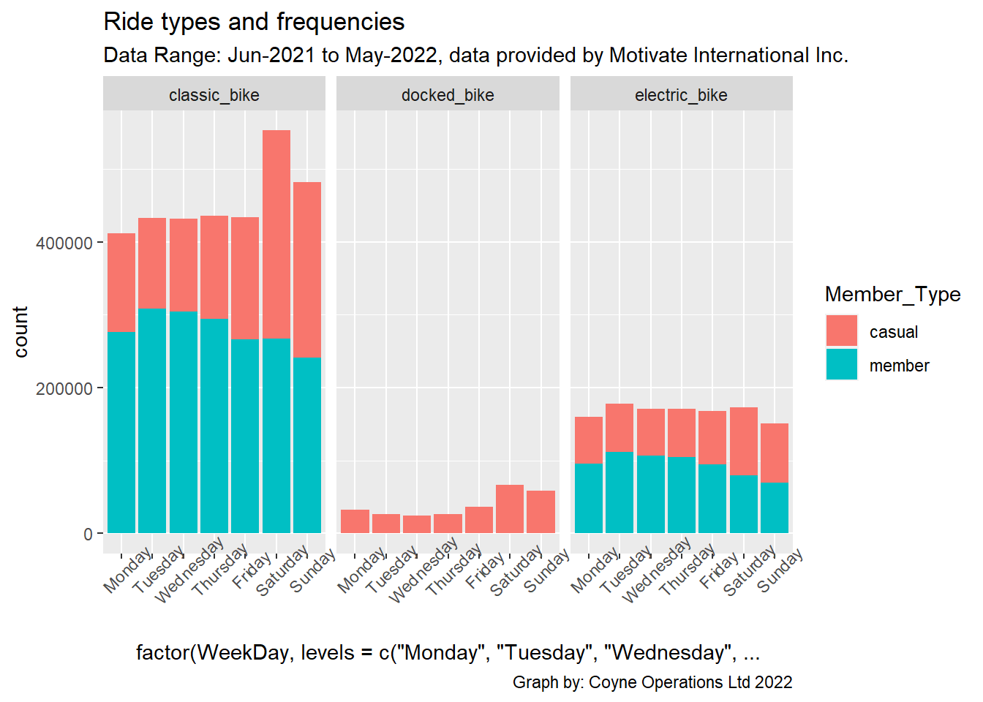
Ride Type by WeekDay June 2011 - May 2022
Weekends are most popular for Casual trips
Weekdays are most popular for commuter member trips
WeekDay

Slide 14
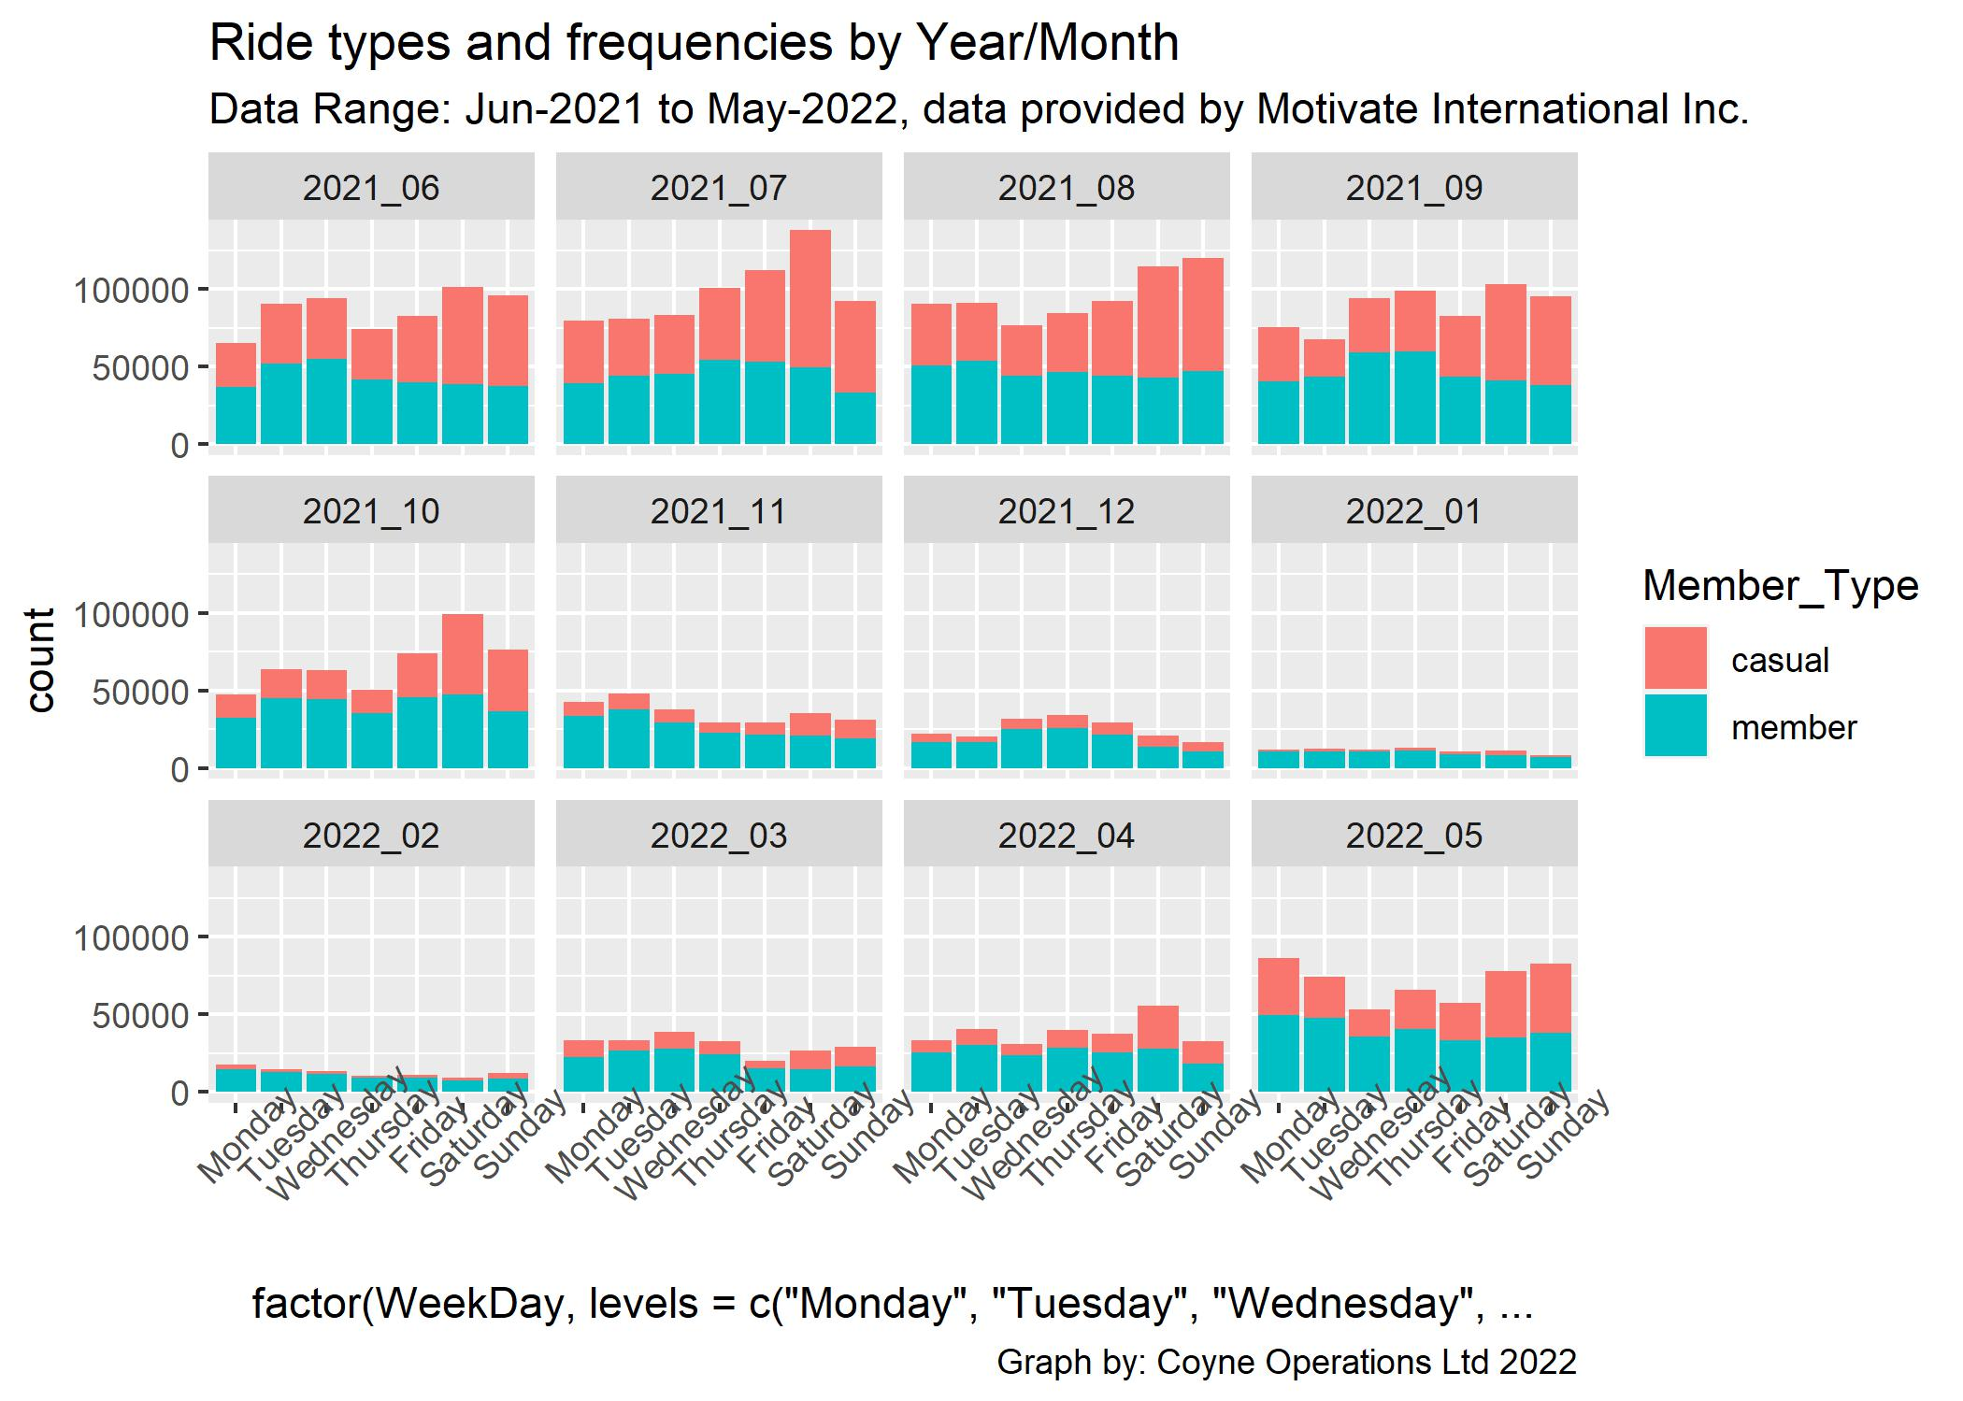
Trip Data per Month over Year June 2011 - May 2022
Weekday trips for commuters/ members fairly consistent throughout year
Casual trips tend to be more active during good weather and weekends
WeekDay

Slide 15
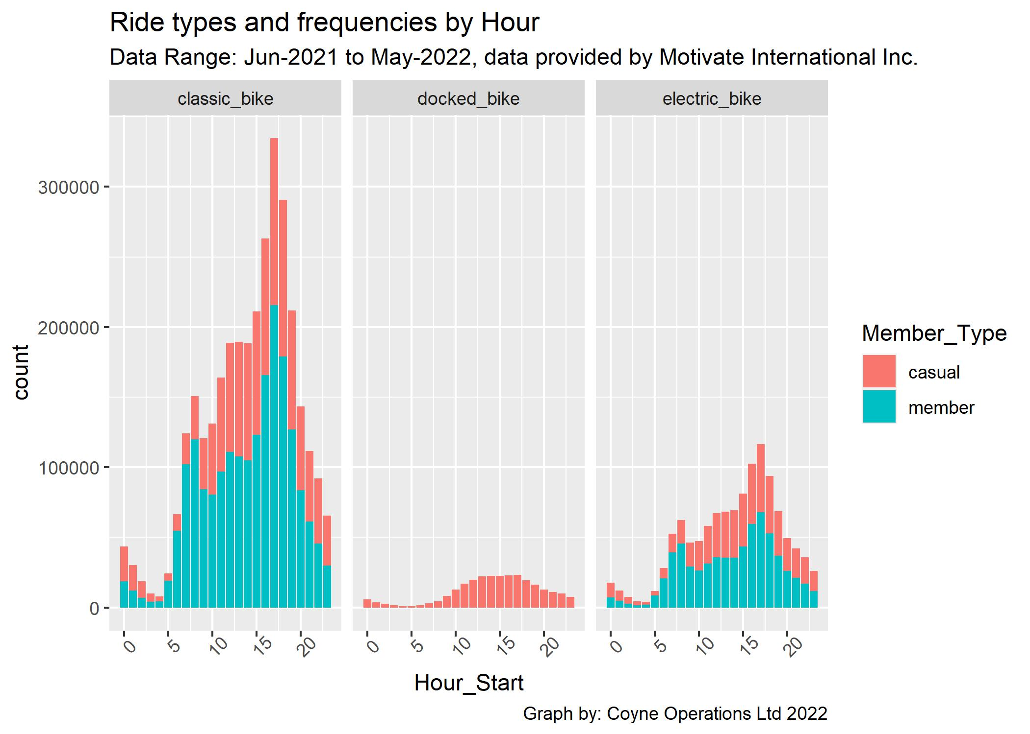
Trip Data per Hour of day June 2011 - May 2022
The hours between 8am and 7pm (rush hour) are the most popular

Slide 16
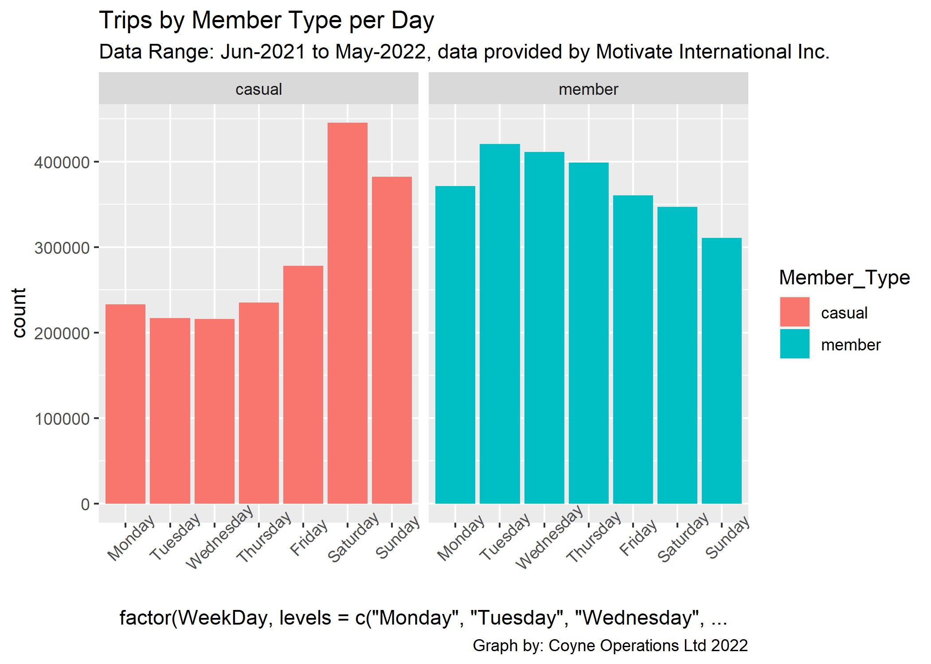
Trips by Member Type per Day June 2011 - May 2022
Weekdays are most popular for commuter member trips
Weekends are most popular for Casual trips
WeekDay

Slide 17
Percentage of Max Rides June 2011 - May 2022
The Maximum durations were casual trips taken in the Summer months

Slide 18
Sum of Rides Totals June 2011 - May 2022
By Member Type / Bike Type Combination
NO Members rode Docked bikes
Vast majority of rides are on Classic bikes

Slide 19
Docked Bikes Trip Data June 2011 - May 2022
The majority of average duration trips are made by Casual users on docked bikes

Slide 20
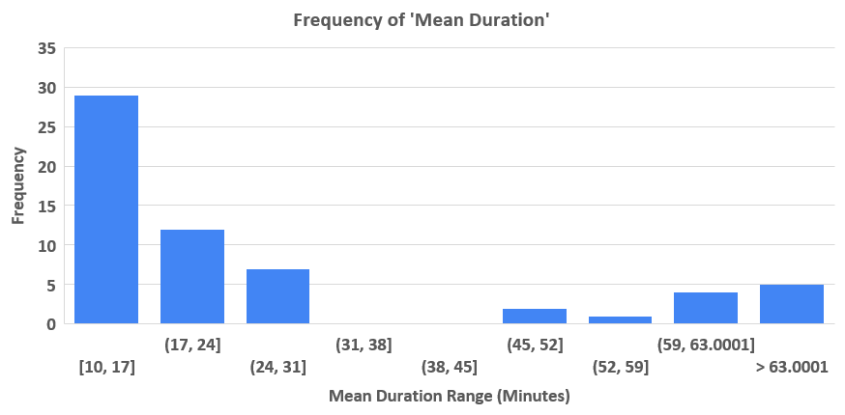
Frequency of Ride Durations June 2011 - May 2022
The OVERALL AVERAGE trip duration was 18 minutes
The AVERAGE trip duration for ALL MEMBERS was 13 minutes
The AVERAGE trip duration for ALL CASUALS was 28 minutes

Slide 21
Minimums, Averages and Maximums June 2011 - May 2022
Key | Member Type | Ride Type | Ride Count | Min Duration | Mean Duration | Max Duration
Casual Classic Bike | Casual | Classic Bike | 1,223,780 | 1 | 26 | 1,500
Casual Docked Bike | Casual | Docked Bike | 272,444 | 1 | 72 | 55,944
Casual Electric Bike | Casual | Electric Bike | 510,127 | 1 | 19 | 480
Member Classic Bike | Member | Classic Bike | 1,958,194 | 1 | 13 | 1,496
Member Electric Bike | Member | Electric Bike | 662,420 | 1 | 11 | 479

Slide 22
Average Trip Duration per Member Type / Ride Type
There were 500,104 “Casual” trips made that were 30mins duration or over … these trip details have been saved for a membership mailshot / survey
The overall trip duration average is 18 mins

Slide 23
Top 10’s of Trip Data June 2011 - May 2022
Top 10 START Stations
Start Station | Freq
Streeter Dr & Grand Ave | 80,905
Michigan Ave & Oak St | 41,927
Wells St & Concord Ln | 41,554
Millennium Park | 39,014
Clark St & Elm St | 38,701
Wells St & Elm St | 35,425
Theatre on the Lake | 34,555
Kingsbury St & Kinzie St | 34,161
Clark St & Armitage Ave | 31,172
DuSable Lake Shore Dr & North Blvd | 31,167

Slide 24
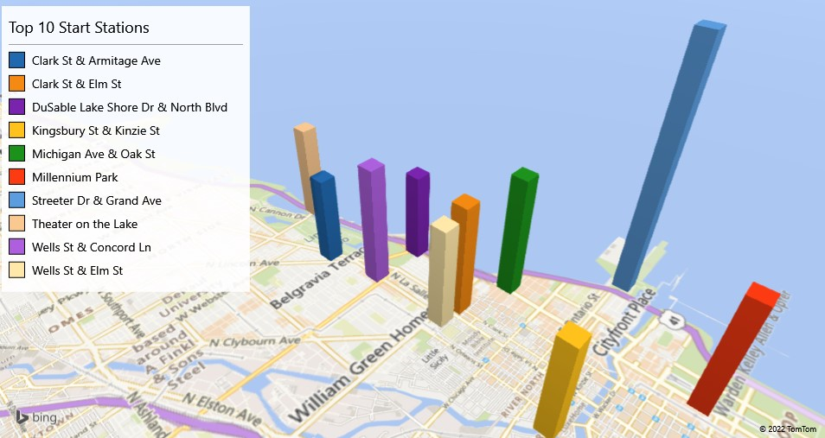
Top 10’s of Trip Data June 2011 - May 2022
Top 10 START Stations

Slide 25
Top 10’s of Trip Data June 2011 - May 2022
Top 10 END Stations
End Station | Freq
Streeter Dr & Grand Ave | 82,331
Michigan Ave & Oak St | 42,696
Wells St & Concord Ln | 41,647
Millennium Park | 40,051
Clark St & Elm St | 37,895
Wells St & Elm St | 35,113
Theatre on the Lake | 34,930
DuSable Lake Shore Dr & North Blvd | 34,581
Kingsbury St & Kinzie St | 33,505
Wabash Ave & Grand Ave | 31,215

Slide 26
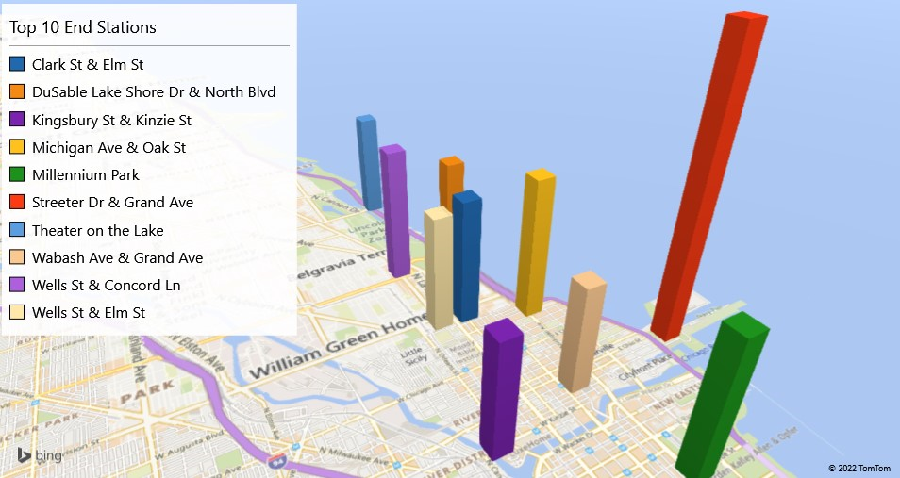
Top 10’s of Trip Data June 2011 - May 2022
Top 10 END Stations

Slide 27
Top 10’s of Trip Data June 2011 - May 2022
Top 10 JOURNEYS
Journey | Freq
Streeter Dr & Grand Ave to Streeter Dr & Grand Ave | 12,282
Ellis Ave & 60th St to University Ave & 57th St | 6,283
Ellis Ave & 60th St to Ellis Ave & 55th St | 6,264
University Ave & 57th St to Ellis Ave & 60th St | 5,887
Michigan Ave & Oak St to Michigan Ave & Oak St | 5,858
Ellis Ave & 55th St to Ellis Ave & 60th St | 5,546
DuSable Lake Shore Dr & Monroe St to DuSable Lake Shore Dr & Monroe St | 5,210
Millennium Park to Millennium Park | 5,170
DuSable Lake Shore Dr & Monroe St to Streeter Dr & Grand Ave | 4,340
Streeter Dr & Grand Ave to Millennium Park | 3,756
Some of the most popular journeys are round trips starting and stopping at the same station

Slide 28
Top 10’s of Trip Data June 2011 - May 2022
Top 10 TRIP DURATIONS (in Minutes)
Ride_ID | Type | Member | Duration | Started | Ended
F043F0F6A1AA4F85 | Docked | Casual | 55,944 | 05/06/2021 02:27 | 13/07/2021 22:51
7F0578ABF030FC83 | Docked | Casual | 55,692 | 04/06/2021 22:03 | 13/07/2021 14:15
E6E1E5BFFD72ECEC | Docked | Casual | 52,701 | 05/06/2021 23:33 | 12/07/2021 13:55
99415B003B7E7EEE | Docked | Casual | 49,107 | 08/07/2021 19:29 | 11/08/2021 21:56
8016DC50082D9E93 | Docked | Casual | 47,011 | 05/06/2021 21:47 | 08/07/2021 13:18
89F33397EABB55E7 | Docked | Casual | 41,646 | 08/07/2021 15:13 | 06/08/2021 13:18
E25E58F5E94EE351 | Docked | Casual | 41,629 | 01/08/2021 18:53 | 30/08/2021 16:42
D4E35EE211346690 | Docked | Casual | 40,725 | 10/07/2021 15:59 | 07/08/2021 22:43
A310C7270FD730B6 | Docked | Casual | 40,705 | 02/10/2021 18:35 | 31/10/2021 01:00
66F0486D4849C1B9 | Docked | Casual | 40,341 | 03/07/2021 18:39 | 31/07/2021 19:00

Slide 29
Overall Trends for Trip Data June 2011 - May 2022
Trip ride frequency increases over good weather months (May – September) and decreases during the cooler months (October – April)
The vast majority of bike trips (69%) are taken on CLASSIC bikes, by BOTH Members (42%) and Casuals (27%)
Docked bikes only used by Casual riders. No Docked trips being made by Members
Weekends and good weather days were most popular for casual bike trip riders
Commuter Members trips remained high during year peaking weekday rush hours
Majority of rides started from 8am through to 9pm, peaking between 3pm-7pm
Average duration of Trip rides increased over good weather months (May – Sept) and decreases during the cooler months (Oct – April)
The AVERAGE OVERALL duration time of a bike journey was 18 MINUTES
The AVERAGE duration time of a MEMBERS bike journey was 13 MINUTES
The AVERAGE duration time of a CASUALS bike journey was 28 MINUTES
Most trips are ROUND trips starting and ending at the same pick-up point, with Streeter Dr & Grand Ave being by far the most popular station

Slide 30
Other important citations and factors for membership
https://www.betterhealth.vic.gov.au/health/healthyliving/cycling-health-benefits lists many benefits, including: Low impact, easy, good for muscles, strength, stamina, & aerobic fitness, varying intensities, fun, time-efficient, obesity and weight control, less stress
https://www.greenvacations.com/blog/the-five-most-bike-friendly-us-cities-for-tourists/
Which named Chicago as one of the Top 5 most bike-friendly US cities
https://www.who.int/tools/heat-for-walking-and-cycling the World Health Organisation (WHO) study - Health Economic Assessment Tool (HEAT) for walking and cycling concludes "Cycling and walking promotes health and has positive effects on the environment"
https://www.cycleplan.co.uk/cycle-savvy/environmental-benefits-of-cycling/#:~:text=Improving%20biodiversity%20is%20another%20important,wildlife%20that%20exists%20within%20them Study on “Why Cycling Is Good For The Environment” lists
1. Cycling reduces air pollution
2. Cycling reduces noise pollution
3. Cycling boosts biodiversity and protects green spaces
4. Cycling reduces the need for deforestation
5. Cycling helps to reduce global warming

Slide 31
Recommended Actions / Next Steps
As per the analysis brief, we are looking to a TARGET audience of CASUAL riders that routinely have trip durations >= 30mins as this is a viable break-even point to survey them to determine their tolerance for taking up membership.
For cost effectiveness, the membership survey should be held on social media, and sent by email, also some street-level surveys held at the most popular pick up point STREETER DR & GRAND AVENUE to have the best catchment chances
The survey should extol eco-friendly, cost effectiveness and health benefits of membership to casual riders (if they frequently have trips >= 30 mins)
Survey launch should start a month PRIOR to expected annual in bike trips (April-May) when improving weather prompts most casuals to consider taking bike trips. It should also target cycling pro-active social media groups, such as https://www.greenvacations.com/blog/the-five-most-bike-friendly-us-cities-for-tourists/ which named Chicago as one of the Top 5 most bike-friendly US cities
Another consideration is the issue of the collection of trip data that needs to be addressed in the number of trips that do not meet the required data standards / criteria (i.e. Missing Start/End locations, no end / finish data) - There were a total of 5,860,776 individual bike trip records provided, of which 4,667,299 cleansed / acceptable records were used for analysis

Slide 32
Insights and Recommendations
Surveying Casual Riders for Membership
Other issues
For cost effectiveness the survey should target casual riders that frequently takes trips of 30mins and over, as determined by the Ride Id and trip Duration (500,104) (Casual_Over30.csv)
The health benefits and the eco-friendliness of frequent cycling compared to other forms of transport and cost effectiveness of membership should be strongly stressed
Target casual riders via social media (Twitter, Facebook and Instagram), email and in person at the premium bike pickup locations – especially Streeter Dr & Grand Ave
The survey should start in April prior to the boom-time in trips, when customers may considering a few upcoming bike rides
The most frequent hours for rides are 3pm-7pm, the most popular trip days are the weekends
2,046 trips >= 1,000 mins (Top_Outliers_tripdata)
Address the issue of collecting incomplete trip data where a number of trip entries do not meet the required criteria (i.e. Missing Start/End locations, no end / finish data)
Cleaner datasets enable more accurate analysis and therefore better management of the business
The survey should also collect data that can be used for future-proofing and upgrading the systems, such as reason for trip, gender, age, contact details, pros & cons, comments on what are we getting right and suggested improvements
The attraction factors for bike trips include job density, location of tourist attractions, and proximity to parks and recreation. They also consider network facilities and infrastructure features like rail stations, bike lanes and bus stops
Twitter, Facebook and Instagram are current social media leading platforms and have many “groups” dedicated to cycling, eco and health issues

Slide 33
Bike Trip Analysis for Cyclistic Ltd. 13th August 2022
Questions?
My case study files:
Website: https://ccjobfind.wixsite.com/mr-colin-coyne
GitHub Files: https://github.com/GitH2018/CC_DataAnalysis
HTML Website for R markdown: Course_8_Bike_Study_FULL.html
R markdown file (RMD): Course_8_Bike_Study.rmd
Powerpoint Presentation: Course 8 - Bike Data Analysis.pptx
Several other Excel/CSV files used in the analysis are available on request
This presentation is by Colin Coyne of Coyne Operations Ltd. coyneops@gmail.com 07973 831 082

Slide 34
Presentation Evaluation Checklist Notes: Do I use an attention-grabbing opening? Do I start with broad ideas and later talk about specific details? Do I speak in short sentences? Do I pause for five seconds after showing a data visualization? Do I pause intentionally at certain points? Do I keep the pitch of my sentences level? Do I stand still and move with purpose? Do I have good posture? Do I look at my audience (or camera) while speaking? Do I keep my message concise? Do I end by explaining to my audience why the data analysis matters Now, do the same for your slide deck: Do I include a good title and subtitle that describe what I’m about to present? Do I include the date of my presentation or the date when my slideshow was last updated? Does my font size let the audience easily read my slides? Do I showcase what business metrics I used? Do I include effective visuals (like charts and graphs)?

Slide 35
Presentation Best Practices Check List Notes
Include a title, subtitle, and date
Use a logical sequence of slides
Provide an agenda with a timeline
Limit amount of text on slides. Audience should be able to scan each block of text on slides within 5 seconds
Start with the business task. Focus on the business task and frame the information in the context of the business task.
Establish the initial hypothesis
Show what business metrics you used
Use visualizations
Introduce the graphic by name
Provide a title for each graph
Go from the general to the specific
Use speaker notes to help you remember talking points
Include key takeaways
You can also make edits directly to the presentation to improve it

